Slide 1


University Admission Prediction
Submitted by:-
Gauri Aggarwal (B2020080)
Nikhil Shah (B2020092)
Sam John (B2020107)
Souvik Das (B2020118)
Varsha Satpathy (B2020122)

Slide 2

Introduction
In India, most of the fresh graduate students are inclined towards pursuing Masters programmes in abroad Universities.
Indian students have the ideology that these institutions are at forefront of technology and research; but most of the student population come from middle to low income families and cannot afford to apply for every other foreign university, so they either end up missing out the right ones, taking huge loans or seek advice from consultants, an approach that can be biased and inaccurate.

Slide 3


Problem Statement
Shyam Jain is a fresh engineering graduate who is aspiring to do post graduation in Analytics. He has recently appeared for GRE and TOEFL exams, but is confused on which all foreign Universities to apply for based on his scores, within a limited budget.
What should he do?

Slide 4
Objective
The purpose is to build a model which will help students in shortlisting universities with their profiles. The predicted output would give them a fair idea about their chances for a particular university.
We designed a model using multiple linear regression analysis and integrated it with an interface that would help Shyam identify the universities where he has high chances of getting selected with just few clicks!

Slide 5

Our Approach
Business Understanding
Data Understanding
Data Preparation
Modelling
Deployment

Slide 6
Data description
As our first step, we took a historical dataset of UCLA which contains several parameters that are considered relevant during the application for Masters Programmes abroad.
The parameters included are :
GRE Scores ( out of 340 )
TOEFL Scores ( out of 120 )
University Rating ( out of 5 )
SOP and LOR Strength ( out of 5 )
Undergraduate GPA ( out of 10 )
Research Experience (Yes or No)
Chance of Admission ( ranging from 0 to 1 )
Source: https://www.kaggle.com/mohansacharya/graduate-admissions

Slide 7

Methodology
Data cleaning
Data transformation
Data partitioning
Building a multiple linear regression model
Training and testing the model
Prediction for the final Test Dataset
Creating interface using Shiny package in R

Slide 8
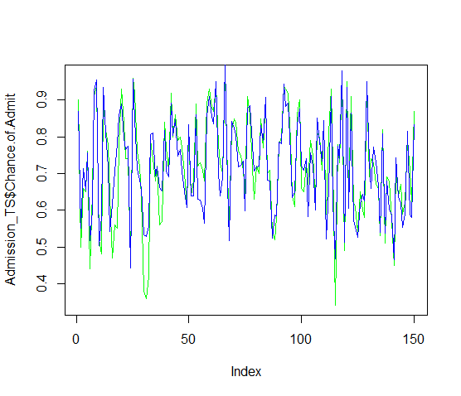

Result
We tried and tested with 8 different models.
The final model was built with Multiple R-squared value= 0.8188 and Adjusted R-squared value= 0.8156 with no heteroscedasticity
Our final significant variables included- GRE and TOEFL score, University Rating, LOR, UG GPA and Research experience
The comparison between actual and predicted values was fairly accurate

Slide 9
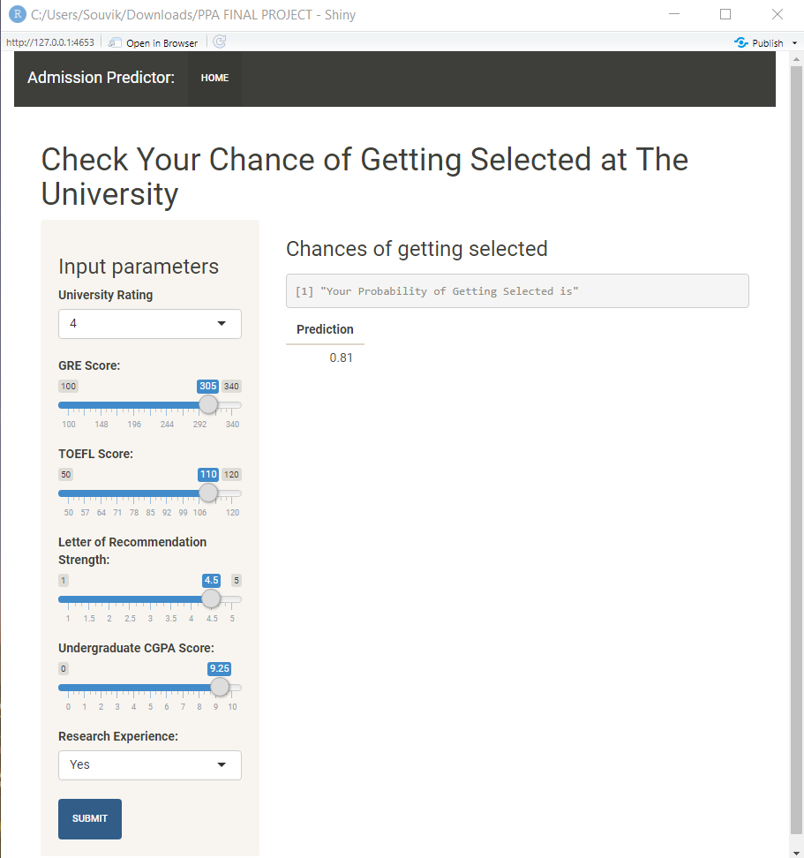
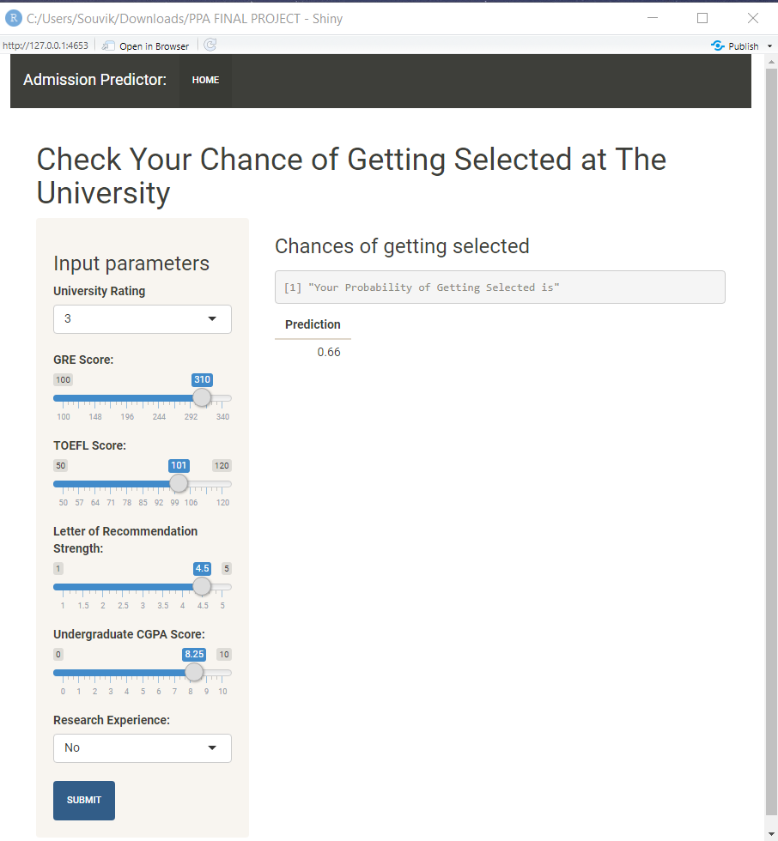
IMPLEMENTATION THROUGH web application
Once the model is evaluated, it was then integrated with a user interface using the Shiny package in R

Slide 10
Conclusion
This model will help the students know the chances of their application to a university being accepted. Also, it will help them in identifying the universities which are best suitable for their profile. They don’t have to be dependent on unreliable websites or pay huge amounts to education consultants, thus saving more money on the application fees.
With this predictive model, Shyam Jain can easily identify his probability of getting admitted in different tier universities based on his scores and other academic records.
Best of luck, Shyam!

Slide 11

THANK YOU !

